Slide 1

Digital Library App
A centralized platform that empowers students, educators, and researchers to access a vast collection of educational resources, fostering a culture of learning and discovery.
BY
Borusu Chaitanya Deepika
Submission Date:-03/07/2024

Slide 2

Problem Statement
Problem:Accessing educational resources can be challenging
Solution: A centralized digital library platform
"Difficulty in finding relevant resources"
"Wasting time searching through multiple websites"

Slide 3

Project Overview
App Name: Digital Library App
Tagline: Explore, Learn, and Grow
Features:
Departmental book browsing
Educational website links
Educational channel links
Storybooks
Objective: To create a user-friendly platform for students
to access educational resources

Slide 4
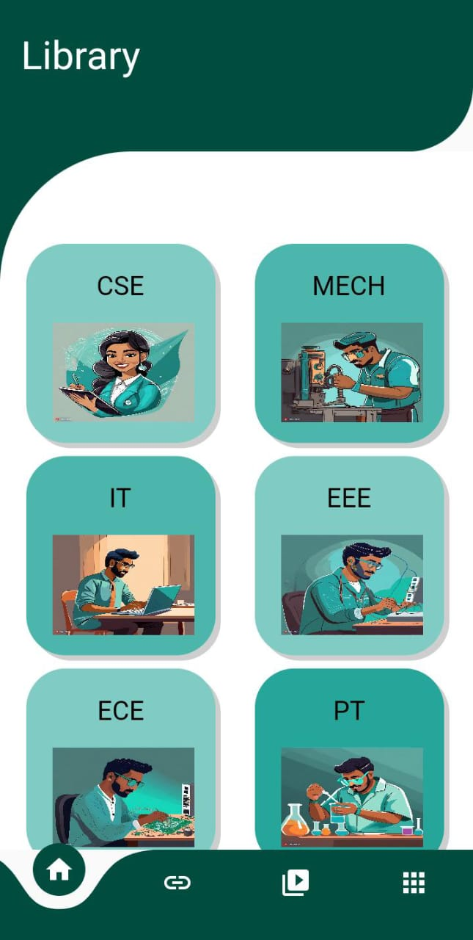
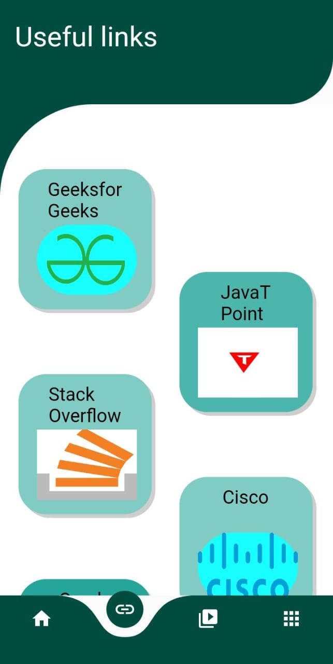
Key Features
Image: Screenshot of departmental book browsing.
Browse books by department: If we want CSE related
books .We can click on CSE which is shown in beside
screenshot ,like Wise we can click on different
branches IT,EEE,ECE, etc.
Access relevant resources easily.
Image: Screenshot of educational website links
Quick access to educational websites
Streamline your search for content

Slide 5
Project Overview

Slide 6





BENEFITS
Easy access to educational resources
Centralized platform for diverse learning materials
User-friendly interface
Virtual learning opportunities

Slide 7
Future developments
A roadmap for a digital library project! These milestonesare crucial steps towards creating an
engaging and personalized learning experience.
Here's a brief explanation of each milestone:
LMS Integration: Integrate the digital library with a Learning Management System (LMS) to
enable seamless access to digital resources, user authentication, and course mapping.
2. AI Recommendations: Implement artificial intelligence-powered recommendation algorithms
to suggest relevant content tousers based on their interests, search history, and learning
behavior.
3. Gamification: Incorporate game design elements and mechanics to encourage
user engagement, motivation, and friendly competition,making the learning experience more
enjoyable and interactive.

Slide 8

CONCLUSION
Digital library is a collection of digital resources, such as e-books,
articles, research papers, and other digital media, that are made
available online for access, browsing, and searching. Digital libraries
provide a platform for users to access and manage digital content,
often with features like search functionality, categorization
and metadata tagging.
They offer various benefits, including:-
Preservation and conservation of digital content
Global accessibility and remote access
Searchability and discoverability
Space

